Slide 1

CSN-254 PROJECT:TREKMATE
Revolutionizing Trek Management
Group Members:
21112097: Shah Krish Sanjay
21115052: Faizan Nabi
20119022: Harsh Pandey
20113046: Deepak Sharma
20113177: Unnati Prasad

Slide 2
FLOW OF THE PROJECT
Introduction
Detail of the Proposed System
Implementation
Screenshots of the System
Future Actions
Conclusion

Slide 3
Introduction
Background- The Himalayan Explorers Club Management System is a web-based application designed to streamline the management of trekking events organized by the Himalayan Explorers Club of IITR.
Motivation- The motivation behind this project stems from the need for an efficient system to manage trek registrations, user profiles, and event details in a centralized platform.
Application Domain- Our webapp focuses on trek management for adventure clubs, addressing registration, profiles, and event logistics. Relevant to organizations hosting outdoor events needing centralized management.
Proposed System-
Comprehensive web application with centralized event and user profile management.
Features include automated payment verification and statistical analysis.
Improves efficiency and user experience with modern web technologies and payment gateways.

Slide 4
Detail of the Proposed System
Key Components:
User Registration and Profile Management
Trek Management
Registration and Payment Handling
Statistical Analysis and Reporting
Innovations:
Integration of Payment Gateways
Use of Machine Learning (LLAMA Model)
Centralized Platform
User-Friendly Interface

Slide 5
Details of the Proposed System
Algorithms:
User Registration Algorithm
Trek Creation and Management Algorithm
Registration and Payment Handling Algorithm
Statistical Analysis and Reporting Algorithm
Application Innovations:
Automated Payment Handling
Machine Learning Integration for Trek Descriptions
Centralized Platform Benefits
User-Friendly Interface Enhancement

Slide 6
Implementation
Backend Development:
Developed using PHP for server-side scripting.
Handles user authentication, data validation, and business logic.
MySQL used for database management.
Frontend Design:
Designed with HTML5, CSS3, and JavaScript.
HTML5 for structure, CSS3 for styling, and JavaScript for interactivity.
Integration of Payment Gateways:
Planned integration with Paytm for secure online transactions.
Utilizes APIs for payment processing and verification.

Slide 7
Implementation
Tools and Technologies Used:
Development Environment: XAMPP
Code Editor: Visual Studio Code
Database Management: phpMyAdmin
LLAMA Model API: Integrates LLAMA model from MetaAI for automatic event detail generation.
Automatic Event Detail Generation:
LLAMA model analyzes internet data to generate detailed event descriptions.
Reduces manual effort and ensures consistency and accuracy.

Slide 8
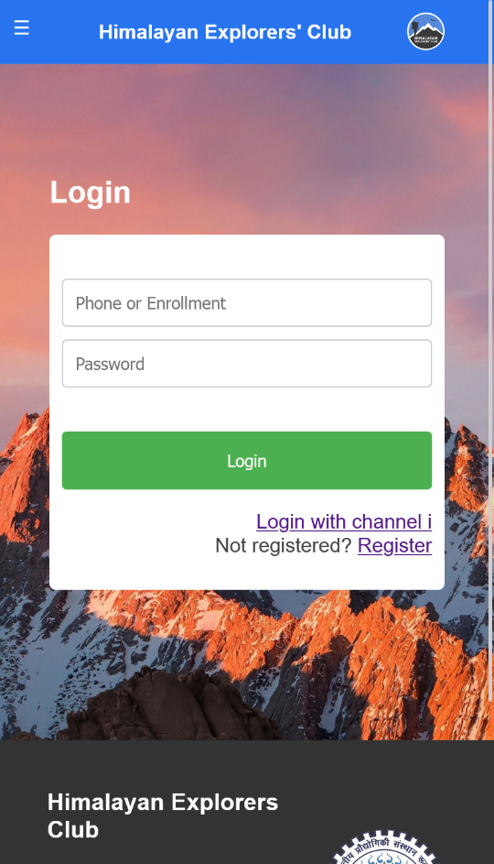
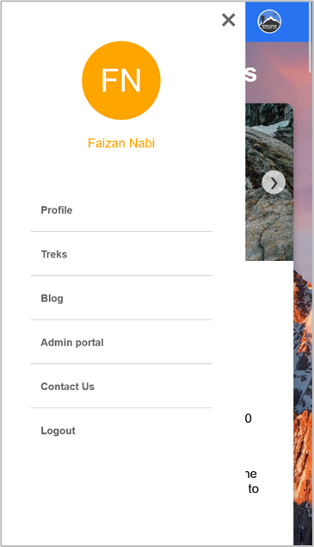
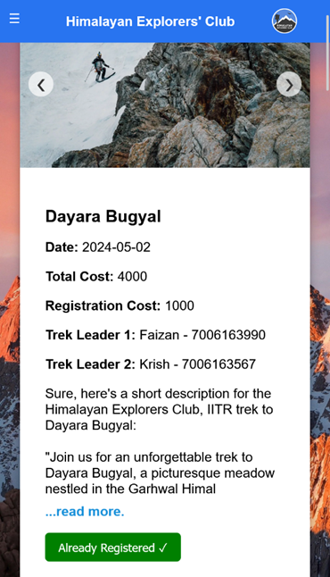
Screenshots of system

Slide 9
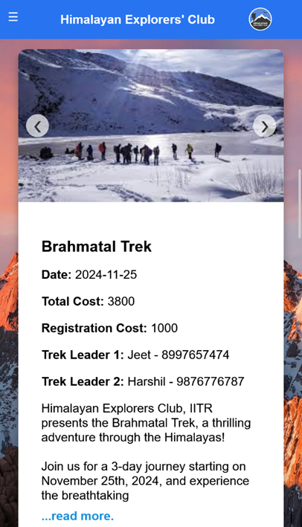
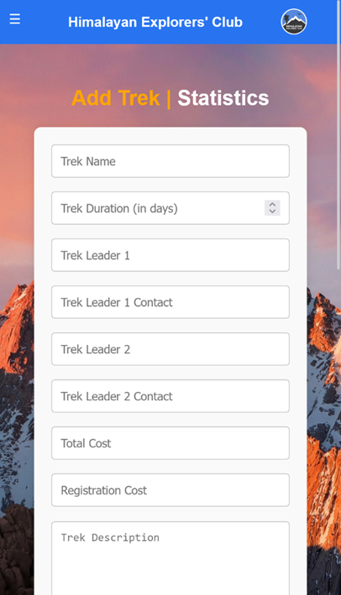
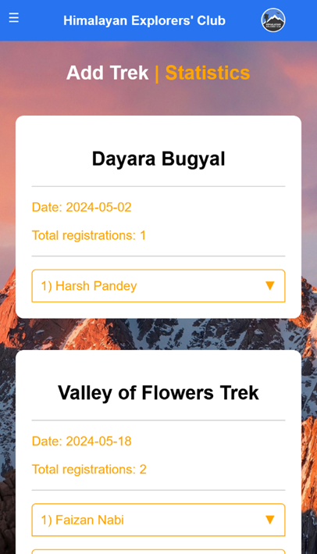
Screenshots of system

Slide 10
Future Actions
We didn’t get enough time to implement the payment handling as getting the API key from Paytm took long so we couldn’t implement it. So we can implement it the future.
We could also integrate LLAMA model to give suggestions to users as to what items to bring to the trek based on the information and fitness level of the user.
We could also implement a attendance feature so that team HEC can take attendance of the attendees while on the trek to keep track of people on the trek efficiently.
We could also build an offline map feature where the offline map of the trek could be added when the trek is uploaded so that users can view the trail while trekking and aren’t lost in the mountains.

Slide 11
Conclusion
Technologies Used: PHP, MySQL, HTML5, CSS3, JavaScript, LLMs (LLAMA Model)
Core Features: Payment Gateways, Statistical Analysis, Centralized Platform
Impact: Streamlined event management, Enhanced user experience, Secure transactions
Future Prospects: Advanced technology integration, Integration with Channel-I
Overall Goal: Revolutionize Himalayan Explorers Club's event management.

